Slide 1
Public Schools and Income
Kayla Fennell

Slide 2
Data Sets and Background
Public Schools Data
State Income Data
Public School and Income Data
I decided to take a look at public school vs income levels for the US but more specifically at a state level. My main driver being my expeirience with researching a compatible school for my neice for this past school year and the trouble I ran into trying to compare stats on different schools and their type. I would anticipate this dashboard being used by parents to grab quick information on a school.

Slide 3
How?
SQL/Jupyter Notebook
Database
HTML/CSS
Built Webpage in HTML
JavaScript
Drop-Downs
Data frames
Cleaning
New Data frames
Used CSS for formatting and layout
Used Plotly for visualizations
Textboxes
Menus
Processing.js to display animations
Read as CSV’s for HTML graphs
Customization
Notes:
Bonus Library to use: Processing.js

Slide 4
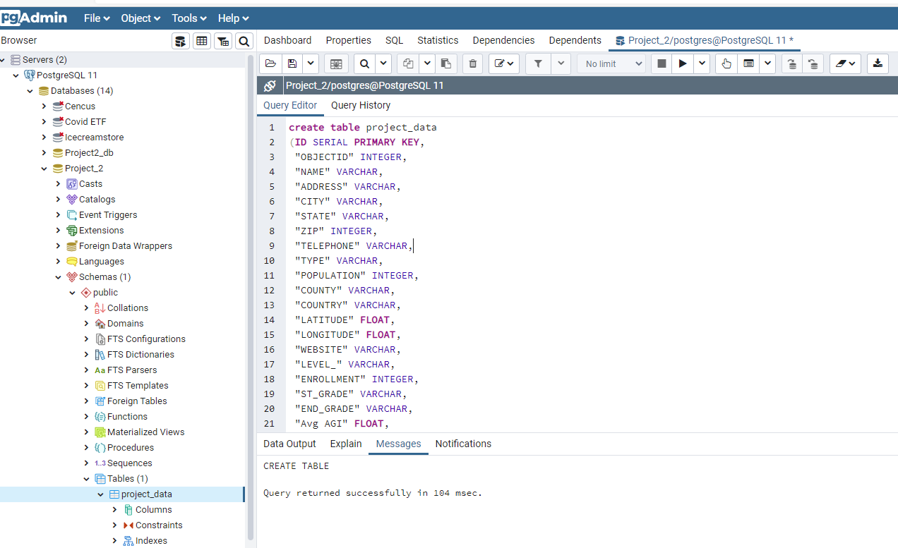
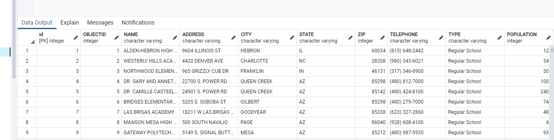
SQL
Notes:
Our process began with loading our Datasets into Postgres to create tables. The apple file ended up not being in all UTF8 encoding. Being this problem had never happened before, I received assistance with converting the file into UTF8 encoding. In order to do this, I had to use the PSQL terminal(a way to communicate with your Postgres Database in the terminal via Python or Ruby).
Psql: \copy (select field_1, field_2, field_3 FROM filename) to '/path/to/your/csv-file.csv' with csv header

Slide 5
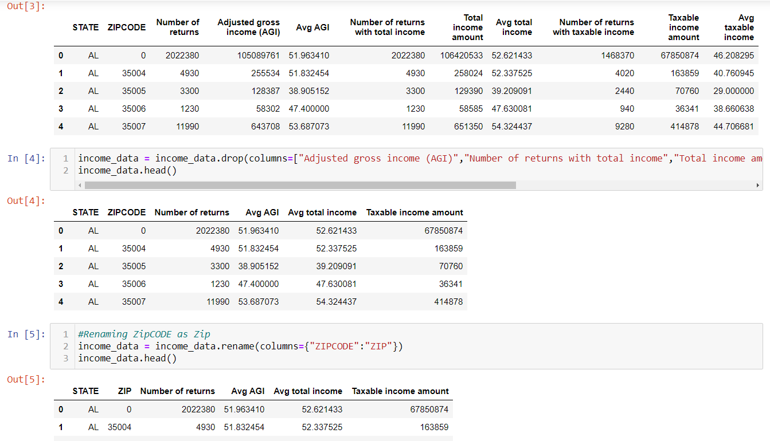
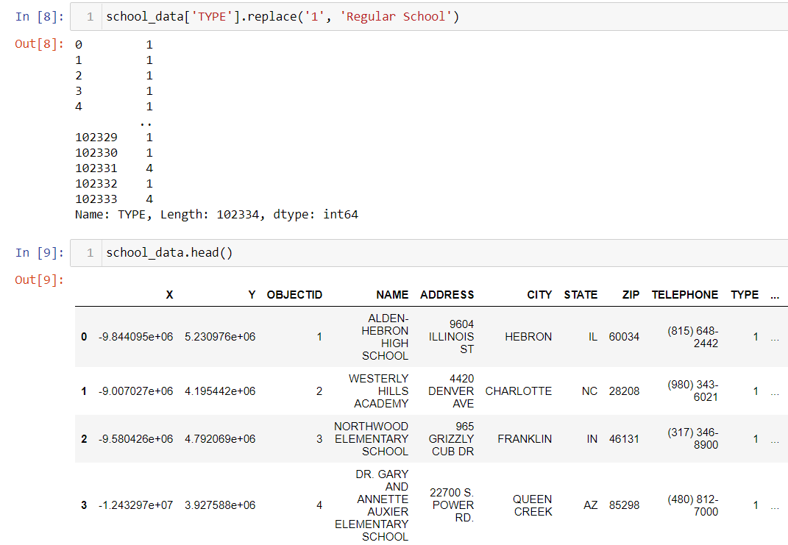
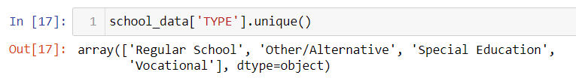
Jupyter Notebook
import pandas as pd
import requests
from sqlalchemy import create_engine
from config import username, pwd
Notes:
Working with Jupyter Notebook, I uploaded the 2 csv files for cleaning. Some of the examples included here show my cleaning processes of dropping columns not needed, renaming columns, and replacing how some of the school data was being read. In order to change replace data names, I had to see what data the column was in and then change it to the correct type in order to be able to apply the new naming system. Also in Jupyter notebook I combined both data sets based off their zip code columns and dropped the last remaining columns not needed.

Slide 6
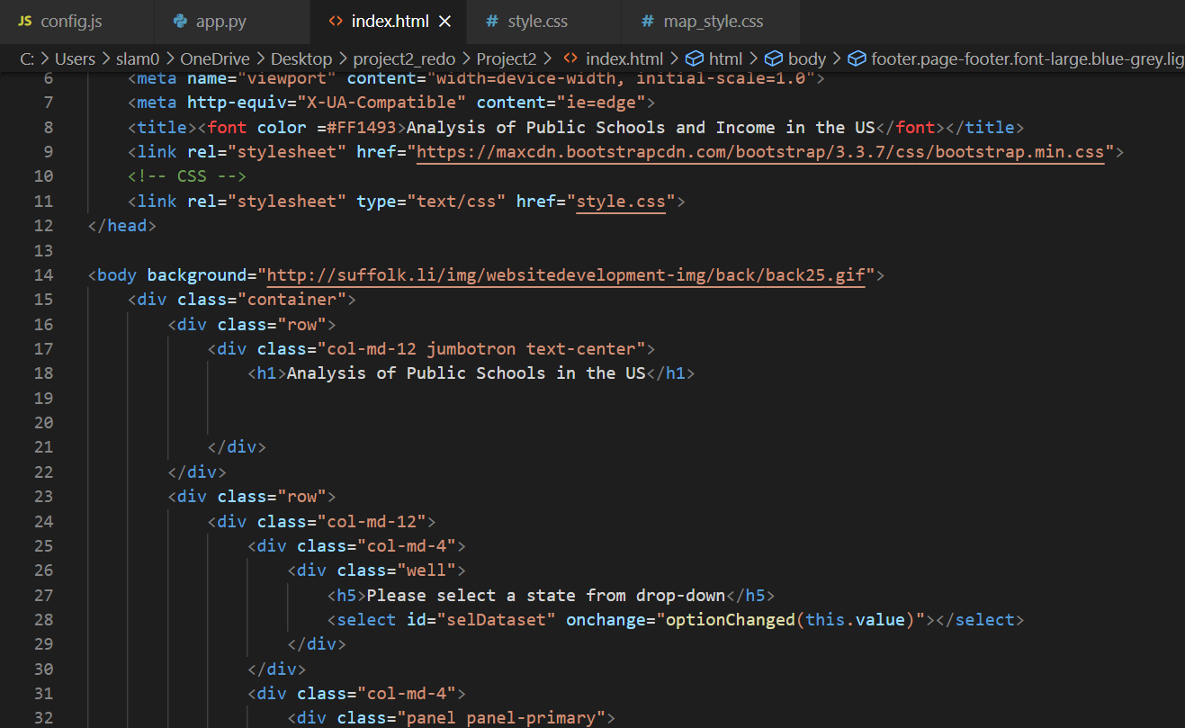
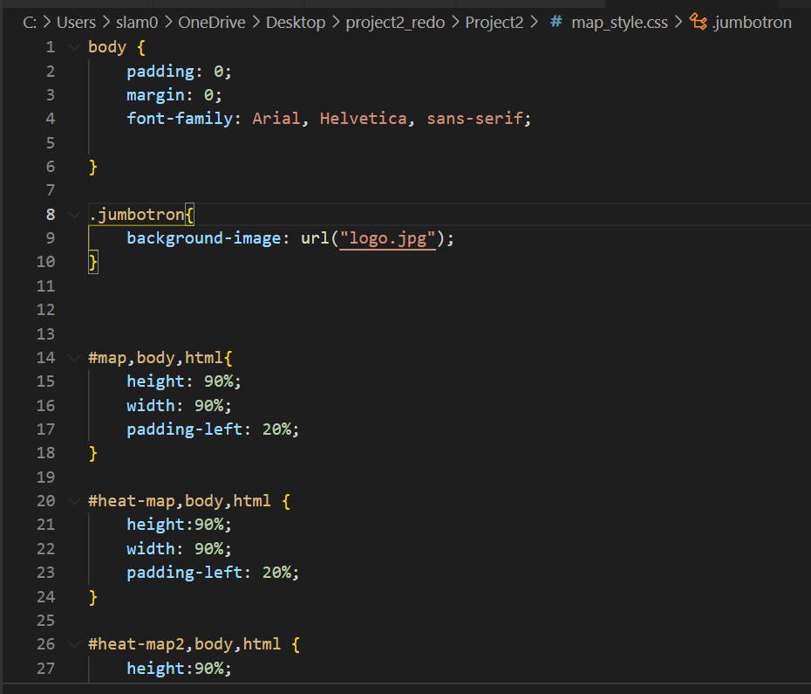
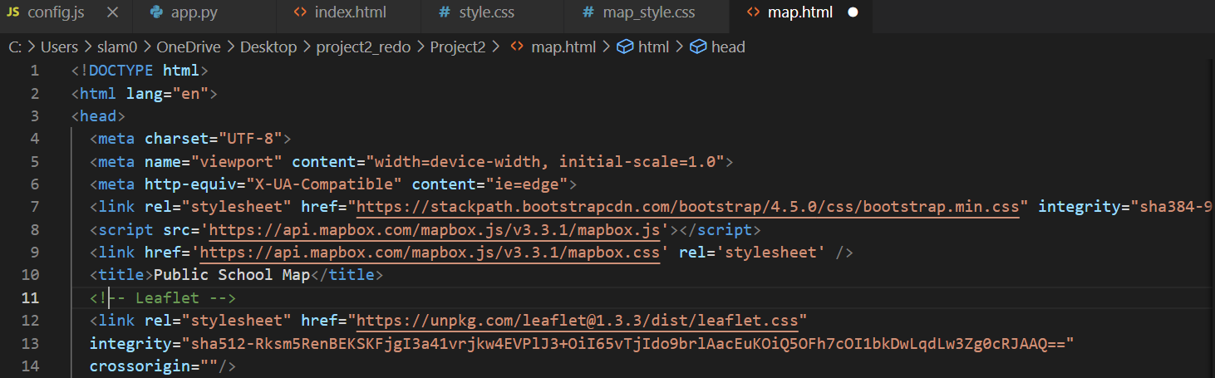
HTML/CSS
Notes:
Visual Studios was used to create the webpage dashboard using HTML(webpage), bootstrap(buttons/navigation), D3(visualizations), and CSS(customize). Using a index file, I added a drop down button for the user to be able to interact with the page and view an overall US view or to narrow down the view and by state. The heat map was completed using leaflet and on the second page you can zoom in/out to check different schools and when clicking on the envelope, the School Name, Address, Telephone number, website(linked), and start and end grade for the school will be shown.

Slide 7
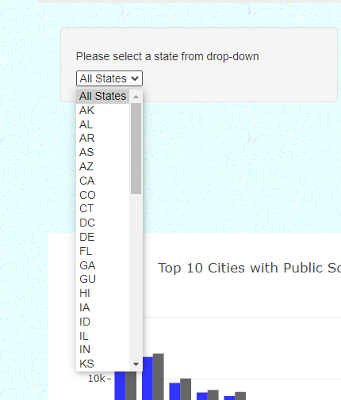
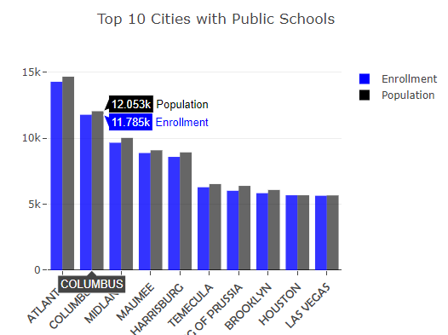
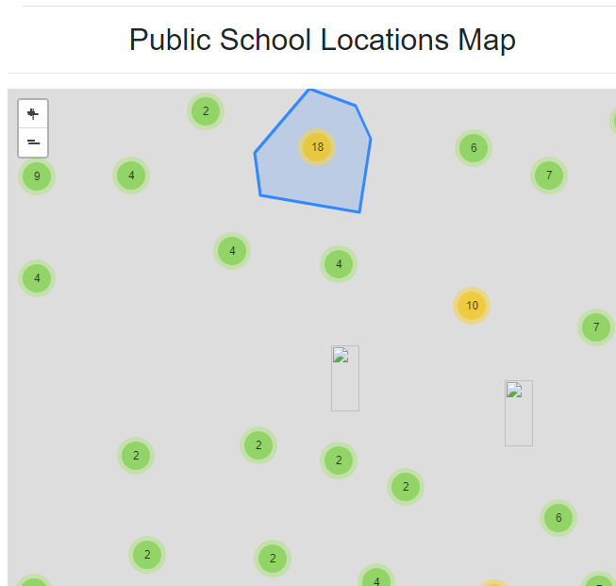
Dashboard

Slide 8


Conclusion
My Dashboard would be ideal for parents, teachers, or students who may be:
Moving soon or recently moved
Need a user friendly way to research schools locally or nationally in one place
Trying to decide which type of school is popular for an area
Considering income levels in an area and the resources available
Curious what options are out there for students
Need additional research on multiple schools

